Slide 1
Deep Neural Networks for Scene Text Reading
Xiang Bai
Huazhong University of Science and Technology

Slide 2
Problem definitions
Definitions
Summary Booklet
Predicting the presence of text and localizing each instance (if any), usually at word or line level, in natural scenes
Scene text detection
End-to-end recognition
Scene text recognition
Converting text regions into computer readable and editable symbols

Slide 3
Outline
Background
Scene Text Detection
Scene Text Recognition
Applications
Future Trends

Slide 4
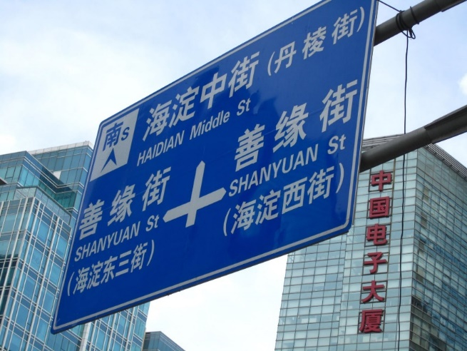
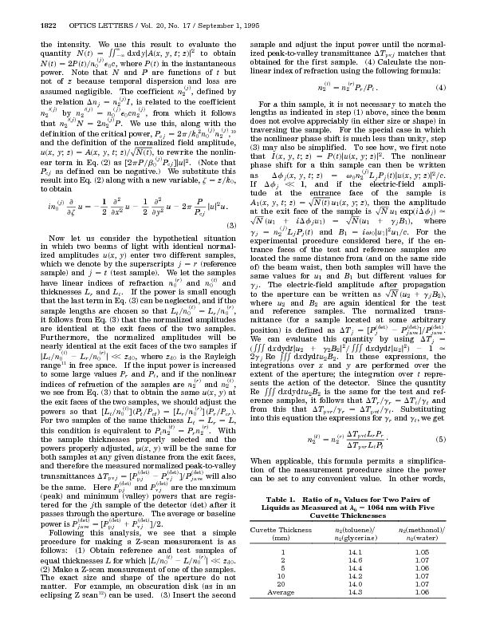
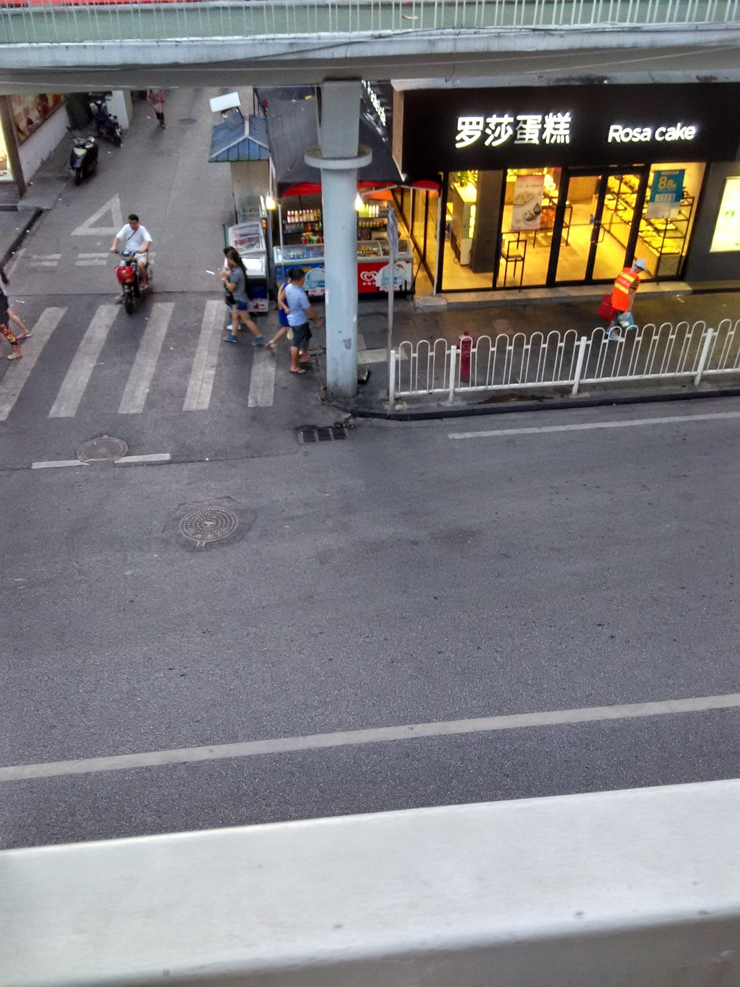
Background
Document image
VS
Scene text image
Scattered and sparse
Multi-oriented
Multi-lingual

Slide 5
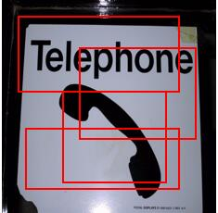
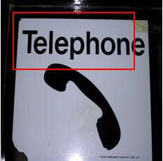
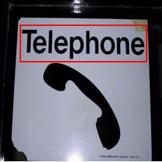
Background
Scene text detection methods before 2016
Proposals
Filtering
Regression
Generate candidates
using hand-craft features
Text / non-text classification
using CNN/Random forest
Refine locations
using CNN
[1] Jaderberg et al. Deep features for text spotting. ECCV, 2014.
[2] Jaderberg et al. Reading text in the wild with convolutional neural networks. IJCV, 2016.
[3] Huang et al. Robust scene text detection with convolution neural network induced mser trees. ECCV, 2014.
[4] Zhang et al. Symmetry-based text line detection in natural scenes. CVPPR, 2015.
[5] LGómez, D Karatzas. Textproposals: a text-specific selective search algorithm for word spotting in the wild. Pattern Recognition 70, 60-74

Slide 6
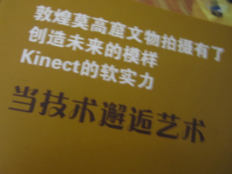


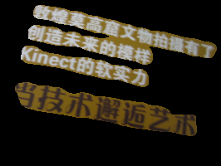
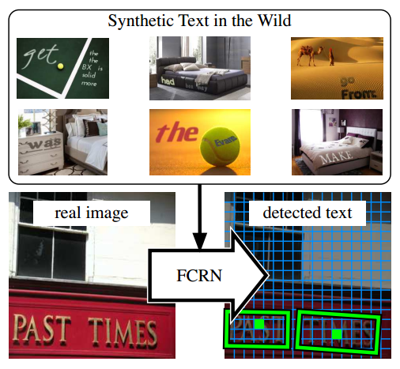
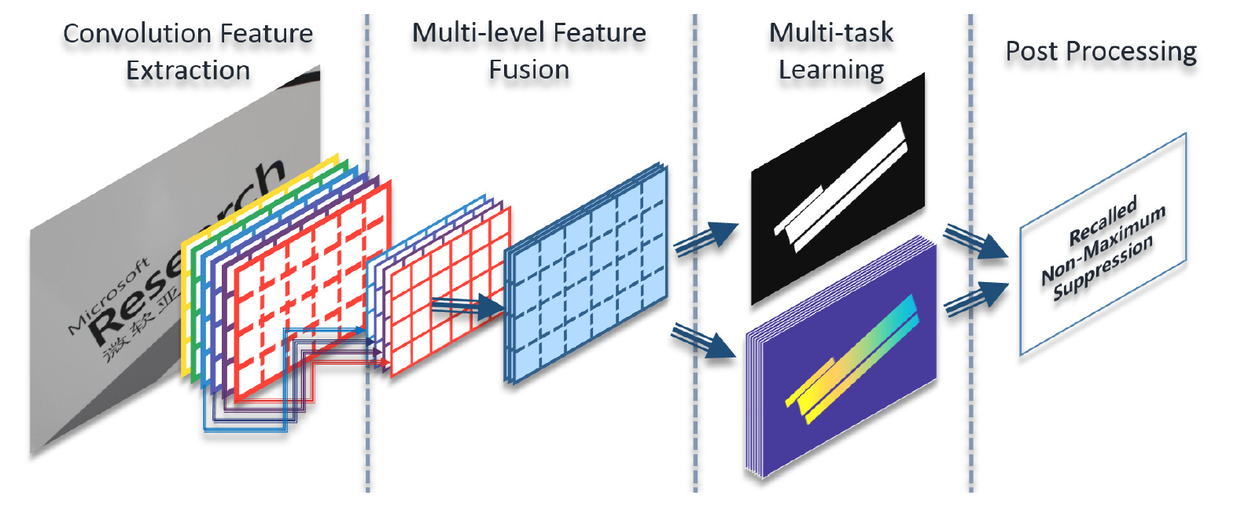
Background
Scene text detectionmethods after 2016
Segmentation-based method[1]
Proposal-based method[2]
Hybrid method[3]
[1] Zhang Z, et al. Multi-oriented text detection with fully convolutional networks. CVPR, 2016.
[2] Gupta A, et al. Synthetic data for text localisation in natural images. CVPR, 2016.
[3] He W, et al. Deep Direct Regression for Multi-Oriented Scene Text Detection. ICCV, 2017
[4] Liao et al. TextBoxes: A fast text detector with a single deep neural network. AAAI, 2017.

Slide 7

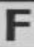



Background
Scene text recognition methods
#words
apple
Word/Char Level^{[1]}
Multi-class classification
with one class per word/char
ball
Word
Classifier
coffee
...
yellow
zoo
a
Sequence Level^{[2][3][4]}
Text is a sequence of chars
The whole sequence is recognized
(
)
...
Char
Classifier
f
...
y
z
-
a
Sequence feature Extractor
-
RNN + CTC
n
“and”
n
d
-
[1] M. Jaderberg et al. Reading text in the wild with convolutional neural networks. IJCV, 2016.
[2] B. Su et al. Accurate scene text recognition based on recurrent neural network. ACCV, 2014.
[3] He et al. Reading Scene Text in Deep Convolutional Sequences. AAAI, 2016.
[4] Shi B et al. An end-to-end trainable neural network for image-based sequence recognition and its application to scene text recognition. TPAMI, 2017.

Slide 8
Background
Recent Trend
Statistics of related papers published in 2017 top conferences
Conference | Detection | Recognition | End-to-end recognition
AAAI-17 | 0 | 0 | 2
IJCAI-17 | 0 | 1 | 0
NIPS-17 | 0 | 1 | 0
ICCV-17 | 5 | 1 | 2
CVPR-17 | 3 | 0 | 0
ICDAR-17 | 8 | 2 | 1
TOTAL | 16 | 5 | 5
Over 80% text detection papers focus on multi-oriented text detection .
Scene text recognition and end-to-end recognition are paid less attention to.
Most papers focus on English text.

Slide 9

Background
Latin text vs. Non-Latin text
English: there is always a blank space between neighbor words
Chinese: no vision cues for partition, while semantic information is needed.
Line-based detection and sequence labeling are appropriate for both Latin and Non-Latin text

Slide 10
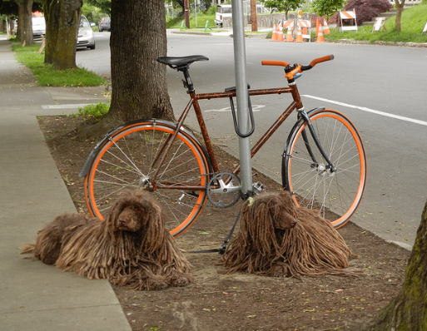
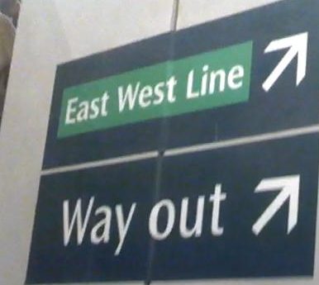
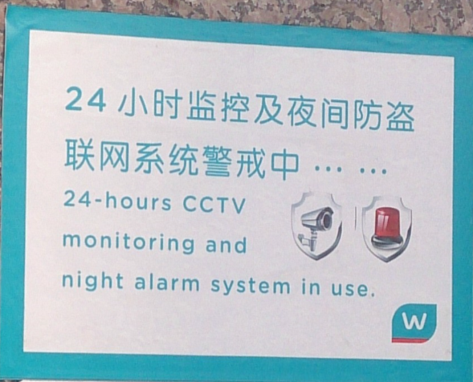
Background
Challenges in Non-Latin text detection
General objects
Words
Text Lines
Unlike general objects and English words, text lines have larger aspect ratios
Given the fixed size of convolutional filters, text lines cannot be totally covered.

Slide 11
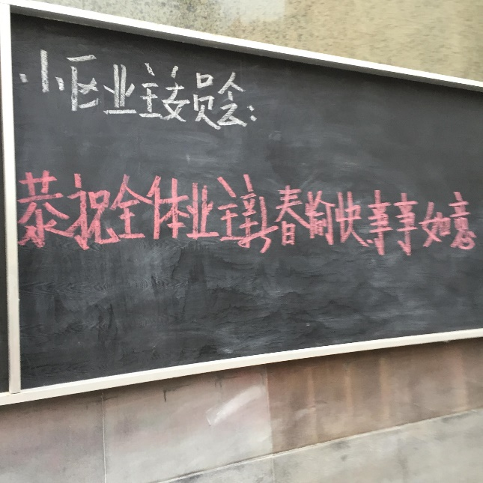
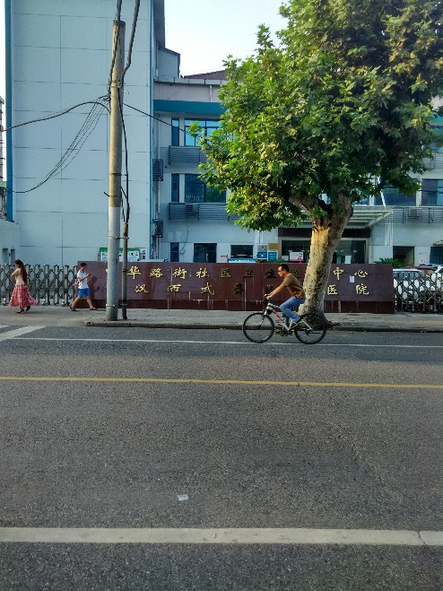
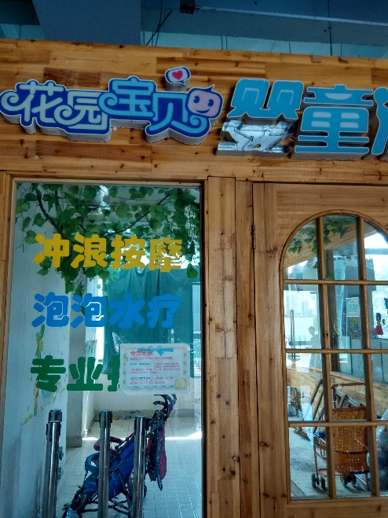
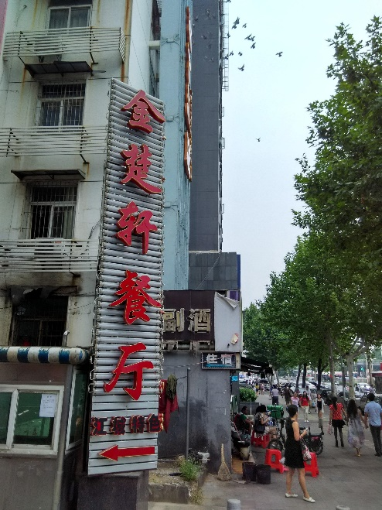
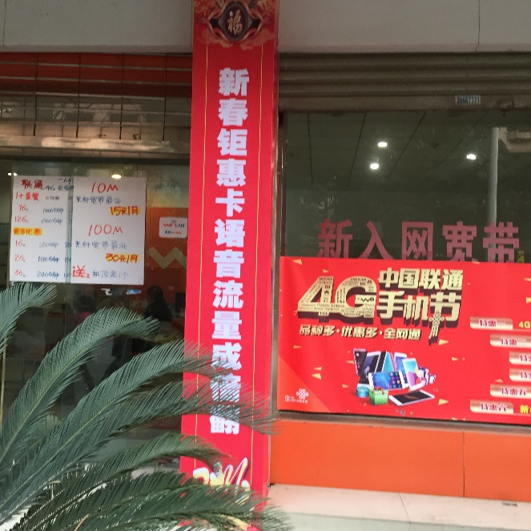
Background
Performance comparison on English / Chinese datasets
Dataset | Language | Num. Train/Test | Best F-measure
ICDAR 2013 | English | 229/233 | 0.90
ICDAR 2015 | English | 1000/500 | 0.81
RCTW 2017 | Mainly Chinese | 8034/4229 | 0.66
The performance of Chinese dataset is much lower.
ICDAR 2017 Competition on Reading Chinese Text in the Wild
Link: http://mclab.eic.hust.edu.cn/icdar2017chinese/

Slide 12
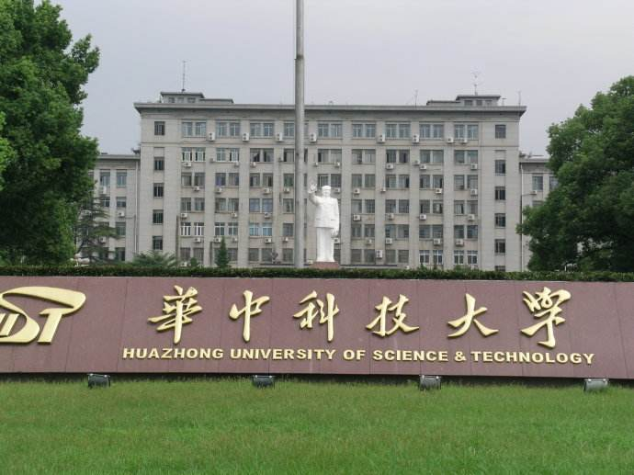
Background
Possible solutions for Non-Latin text detection
Long convolutional kernel.
Inception convolutional kernels.
Part detection and grouping.
Inception convolutional kernels
Long conv

Slide 13
Outline
Background
Scene Text Detection
Scene Text Recognition
Applications
Future Trends

Slide 14
Scene Text Detection
Proposal-based method:
Detecting text with a single deep neural network (TextBoxes)[1]
Part-based method:
Detecting text with Segments and Links (SegLink)[2]
[1] M. Liao et al. TextBoxes: A Fast Text Detector with a Single Deep Neural Network. AAAI, 2017.
[2] B. Shi et al. Detecting Oriented Text in Natural Images by Linking Segments. IEEE CVPR, 2017.

Slide 15
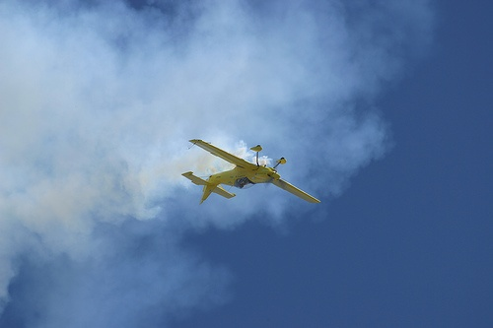
TextBoxes: Horizontal text detection
SSD: Single Shot MultiBox Detector
Default boxes of different ratios and sizes
Classify the default boxes
Regress the matched default boxes
Positive default box
Regressed Result
w
h
(x, y)
w: width;
h: height
(x, y): center point
4×4 feature map
2×2 feature map
[1] W. Liu et al. SSD: Single Shot MultiBox Detector. ECCV, 2016.

Slide 16
TextBoxes: Horizontal text detection
Long convolutional kernels and default boxes
Convolutional kernel
Default boxes
SSD: 3*3 conv
TextBoxes: 1*5 conv
Use SSD as the backbone.
Long default boxes.
Long convolutional kernels.

Slide 17
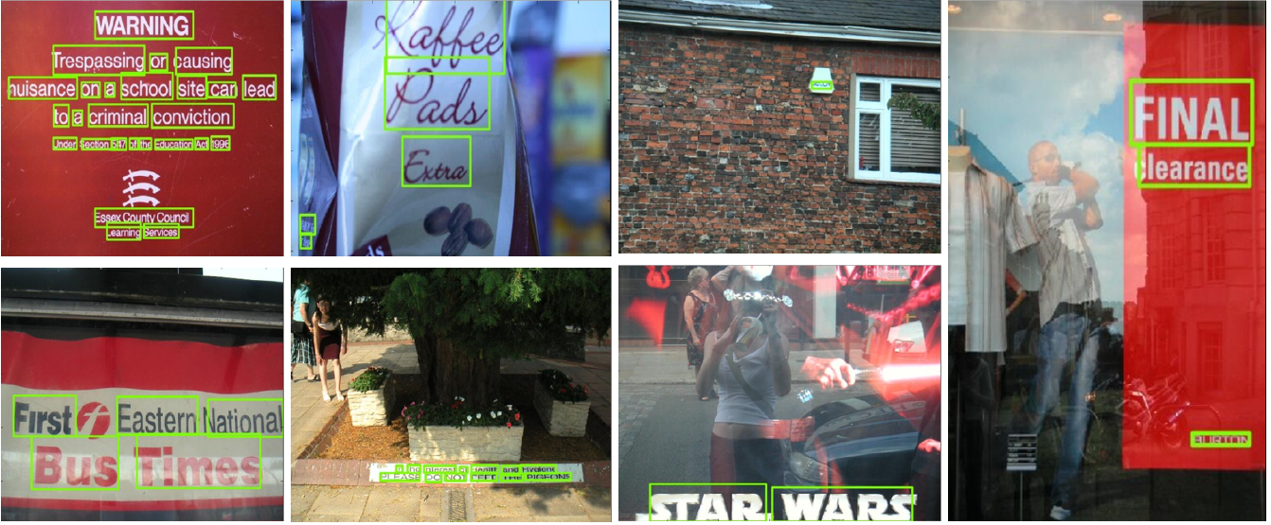
TextBoxes: Horizontal text detection
Experimental Results on ICDAR 2013
Methods | Precision | Recall | F-measure
Jaderberg IJCV16 | 0.89 | 0.68 | 0.77
FCRN CVPR16 | 0.92 | 0.76 | 0.83
Zhang CVPR16 | 0.88 | 0.8 | 0.84
SSD | 0.80 | 0.60 | 0.69
TextBoxes | 0.89 | 0.83 | 0.86

Slide 18

TextBoxes++: Multi-oriented text detection
Text/Non-text Classification
CNN
(x₁, y₁)
(x₂, y₂)
(x₄, y₄)
(x₃, y₃)
(x, y)
h
w
(x_{i}, y_{i}) (i =1,2,3,4) denote coordinates of the bounding box

Slide 19
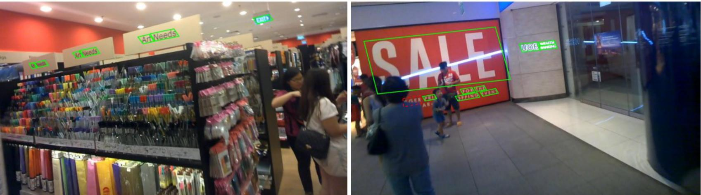
TextBoxes++: Multi-oriented text detection
Text detection results on ICDAR 2015 Incidental Text
Methods | Recall | Precision | F-measure | FPS
SegLink CVPR17 | 0.768 | 0.731 | 0.75 | 8.9
EAST CVPR17 | 0.735 | 0.836 | 0.782 | 13.2
EAST multi-scale CVPR17 | 0.783 | 0.833 | 0.807 | --
TextBoxes++ | 0.767 | 0.872 | 0.817 | 11.6
TextBoxes++_multi-scale* | 0.785 | 0.878 | 0.829 | --
* multi-scale: Testing image with multi-scale inputs

Slide 20
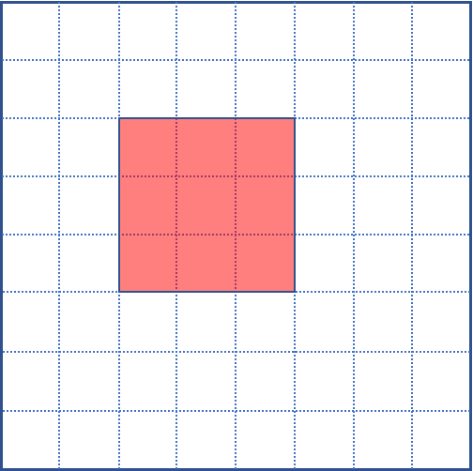
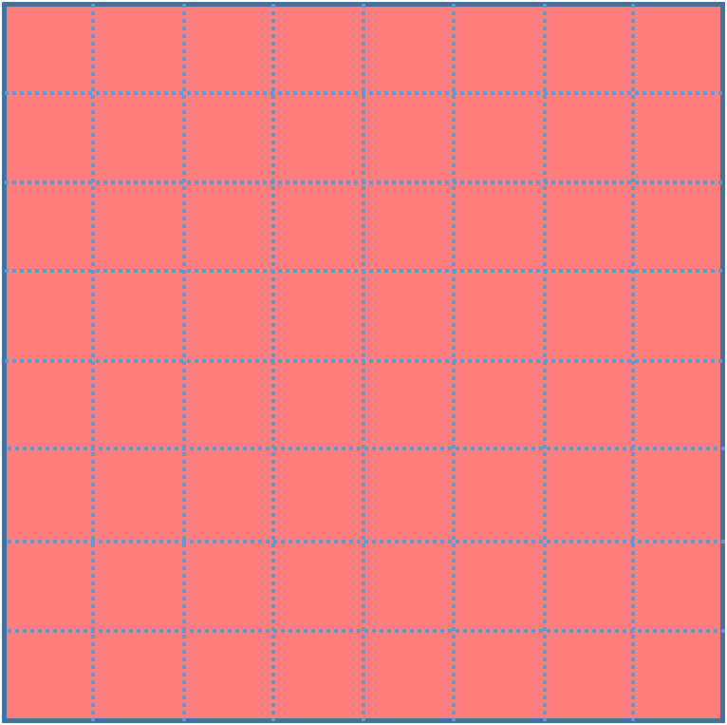




TextBoxes++: Long text line detection
Inception block for long text lines
Inception block contains rich receptive fields
3*3 conv
1*5 conv
Concat
Inception block
5*1 conv

Slide 21
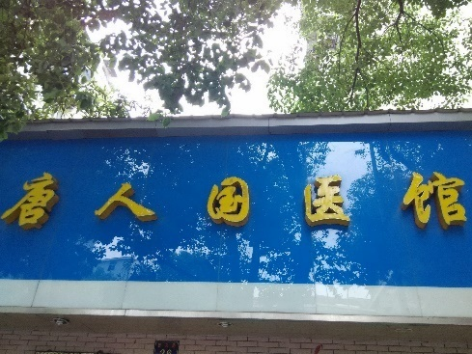
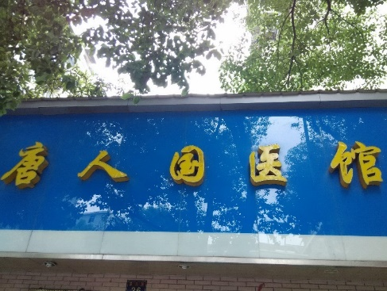
TextBoxes++: Long text line detection
Without inception block
With inception block
A subset of RCTW which mainly consists of images with long text lines.
Performances on RCTW (long)
Method | F-measure
Baseline | 0.6902
Baseline + inception block | 0.7532

Slide 22
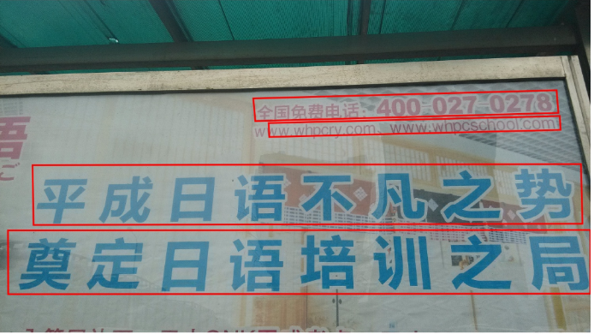
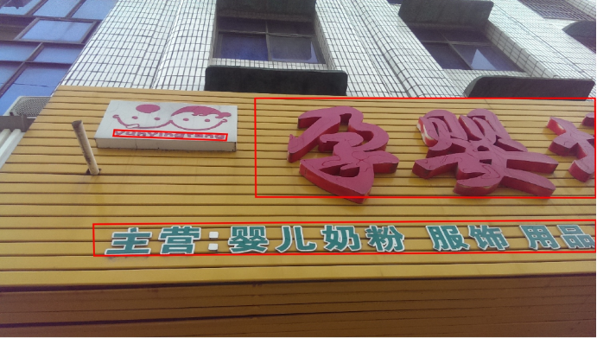
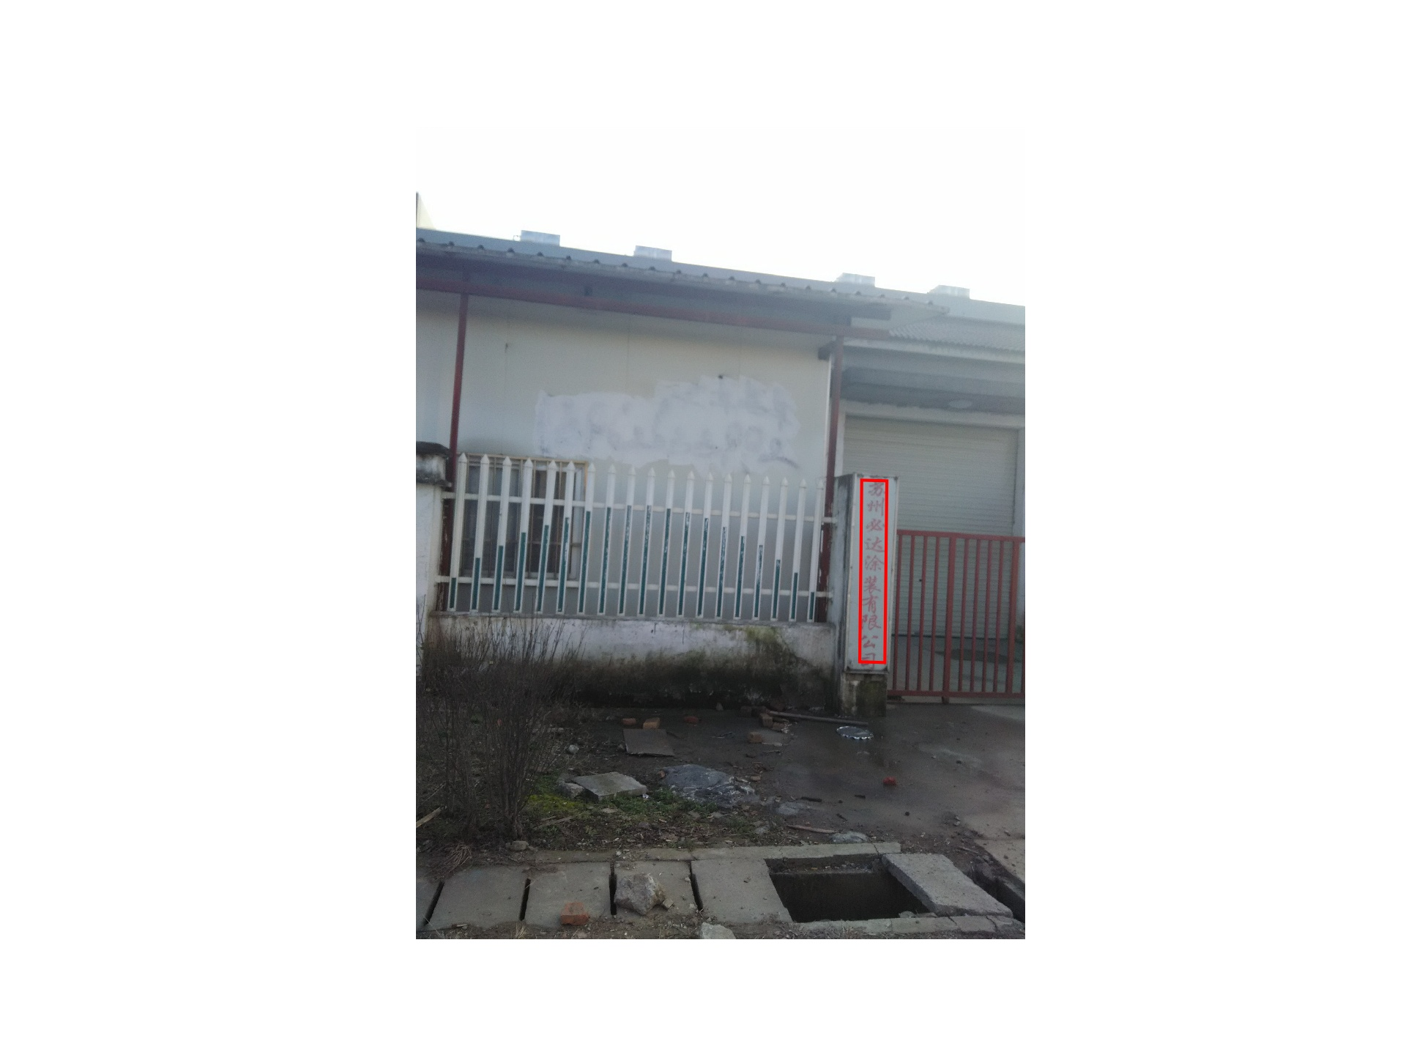
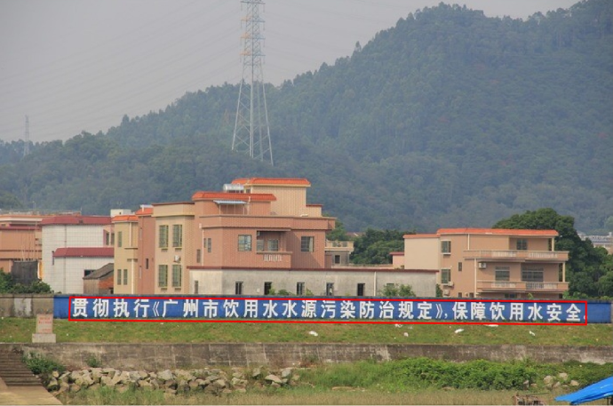
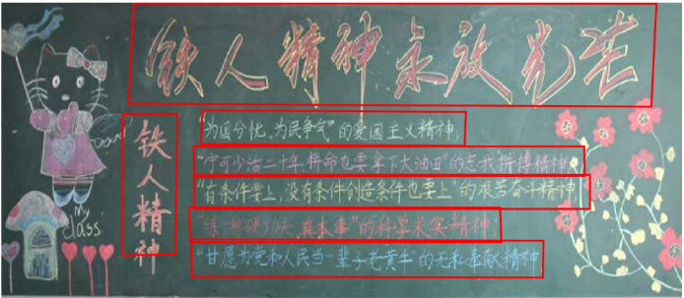
TextBoxes++: Long text line detection
Comparison with competition winners
Team Name | Max F-measure | FM-Rank
Foo & Bar | 0.661054 | 1
NLPR_PAL | 0.657598 | 2
gmh | 0.636024 | 3
TextBoxes++ with inception block | 0.665295 | --

Slide 23
Scene Text Detection
Proposal-based method:
Detecting text with a single deep neural network (TextBoxes)[1]
Part-based method:
Detecting text with Segments and Links (SegLink)[2]
[1] M. Liao et al. TextBoxes: A Fast Text Detector with a Single Deep Neural Network. AAAI, 2017.
[2] B. Shi et al. Detecting Oriented Text in Natural Images by Linking Segments. IEEE CVPR, 2017.

Slide 24
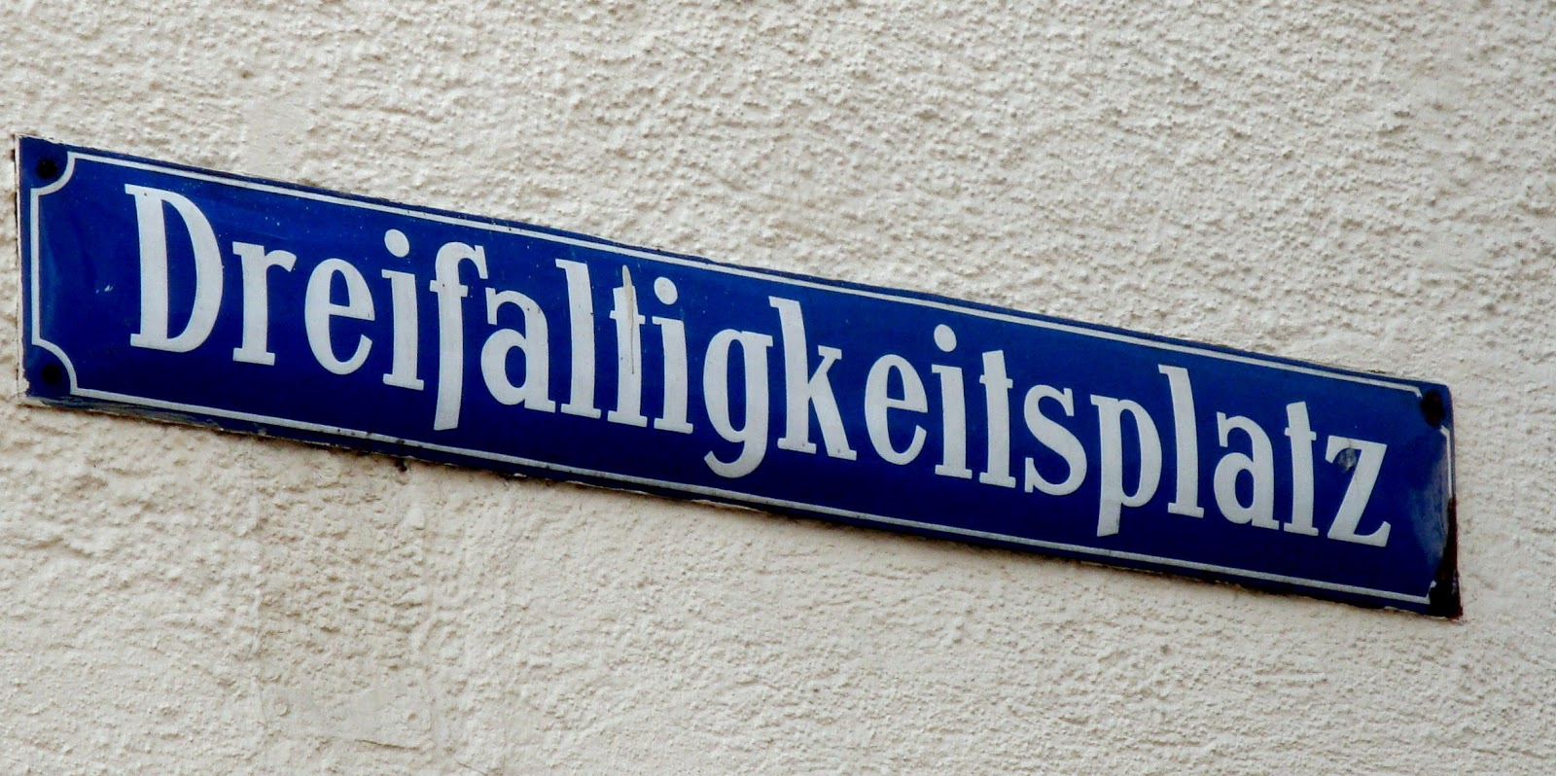
SegLink: Detect long text with segments and links
Large aspect ratio text lines can be detected using limited respective field with Segments and Links
Segments
(yellow boxes)
Links
(green edges)
Combined detection boxes

Slide 25
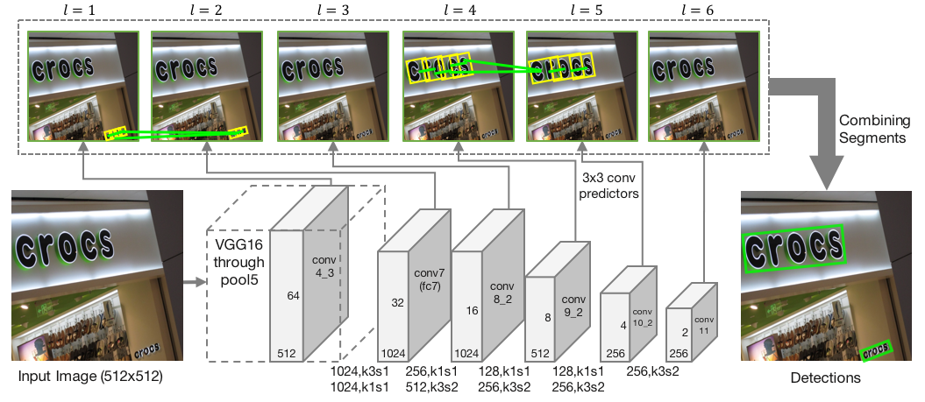
SegLink: Detect long text with segments and links
Fully connected networks based on SSD and VGG16.
Multiscale Segments and Links prediction
Alternative solution to the limited respective field problem of long text lines

Slide 26
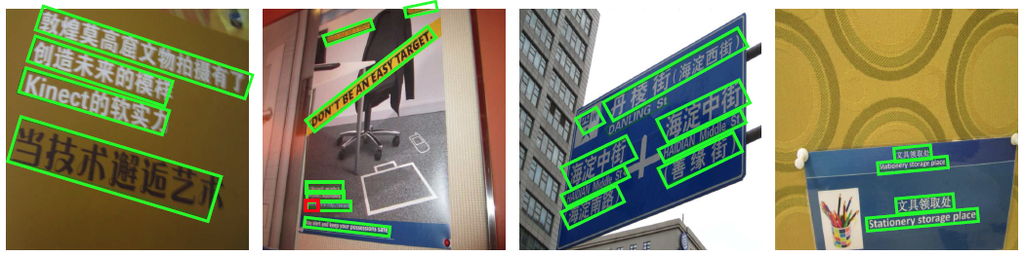
SegLink: Detect long text with segments and links
Results on MSRA-TD500
Results on ICDAR2015
Methods | Precision | Recall | F-measure
Kang et al. (CVPR 2014) | 71 | 62 | 66
Yin et al. (TPAMI 2015) | 81 | 63 | 74
Zhang et al. (CVPR 2016) | 83 | 67 | 74
SegLink | 86 | 70 | 77
Methods | Precision | Recall | F-measure
StradVision-2 | 77.5 | 36.7 | 49.8
CTPN | 51.6 | 74.2 | 60.9
Megvii-Image++ | 72.4 | 57.0 | 63.8
SegLink | 73.1 | 76.8 | 75.0

Slide 27

SegLink: Detect long text with segments and links
Seglink can detect text of curved shape

Slide 28
Outline
Background
Scene Text Detection
Scene Text Recognition
Applications
Future Trends

Slide 29
Scene Text Recognition
CRNN model for Regular Text Recognition
RARE model for Irregular Text Recognition
[1] CRNN: Shi B et al. An end-to-end trainable neural network for image-based sequence recognition and its application to scene text recognition. TPAMI, 2017.
[2] RARE: Shi B et al. Robust scene text recognition with automatic rectification. CVPR, 2016.

Slide 30
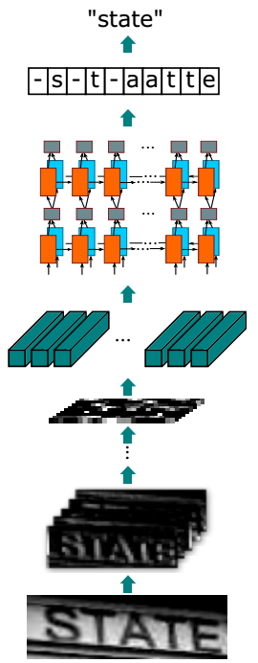
CRNN for Regular Text Recognition
The Network Architecture
CTC
Network Structure
RNN
Convolutional layers extract feature maps
Convert feature maps into feature sequence
Sequence labeling with LSTM
Translate labels to text
CNN

Slide 31

CRNN for Regular Text Recognition
Sequence Modeling
Feature Sequence
···
···
Receptive field

Slide 32
CRNN for Regular Text Recognition
Comparisons
Advantages
End-to-end trainable
Free of char-level annotations
Unconstrained to specific lexicon
40~50 times less paramters than mainstream models
Better or comparable performance with state-of-the-arts
Results(lexicon-free)
Method | IIIT5K | SVT | IC03 | IC13
Bissacco et al. (ICCV13) | - | 78.0 | - | 87.6
Jaderberg et al. (IJCV15)* | - | 80.7 | 93.1 | 90.8
Jaderberg et al. (ICLR15) | - | 71.7 | 89.6 | 81.8
Proposed | 81.2 | 82.7 | 91.9 | 89.6
*is not lexicon-free, as its outputs are constrained to a 90k dictionary

Slide 33
Scene Text Recognition
CRNN model for Regular Text Recognition
RARE model for Irregular Text Recognition
[1] CRNN: Shi B et al. An end-to-end trainable neural network for image-based sequence recognition and its application to scene text recognition. TPAMI, 2017.
[2] RARE: Shi B et al. Robust scene text recognition with automatic rectification. CVPR, 2016.

Slide 34
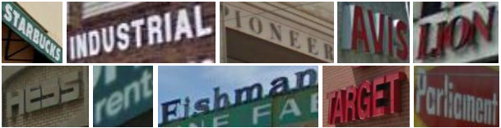

RARE for Irregular Text Recognition
Motivation
Perspective and curved texts are hard to recognize!
SVT-Perspective
(a) Perspective texts
CUTE80
(b) Curved texts

Slide 35

RARE for Irregular Text Recognition
Attention-based Sequence Recognition
Input Image
Sequence
Recognition Network (SRN)
S
M
Z
O
M
O
S
Z
SRN: an attention-based encoder-decoder framework
Encoder: ConvNet + Bi-LSTM
Decoder: Attention-based character generator
Results
Method | IIIT5K | SVT | IC03 | IC13 | SVT-Per | CUTE80
SRN | 83.6 | 84.9 | 93.6 | 91.8 | 68.2 | 62.5

Slide 36

RARE for Irregular Text Recognition
STN (Spatial Transform Network)^{[1]} for Text Rectification
Input Image
Rectified Image
Spatial
Transformer Network (STN)
Sequence
Recognition Network (SRN)
''MOSZ''
''MOON''
An end-to-end trainable network
STN: rectifies images with spatial transformation
SRN: an attention-based encoder-decoder framework
[1] Jaderberg M et al. Spatial transformer networks. NIPS, 2015.

Slide 37
RARE for Irregular Text Recognition
Spatial Transformer Network (STN)
Localization Network
Grid
Generator
C
P
C'
Sampler V
Rectified Image I'
Input Image I
Localization Network: A CNN that predicts the fiducial points.
[1] Jaderberg M et al. Spatial transformer networks. NIPS, 2015.

Slide 38
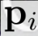

RARE for Irregular Text Recognition
Spatial Transformer Network (STN)
C
T
C'
Grid Generator: Computes a Thin-Plate-Spline (TPS) transform, T, from the fiducial points C.
Sampler: TPS-Transform input image I into rectified I'.
Standard datasets
Deformable text datasets
Results
Method | IIIT5K | SVT | IC03 | IC13 | SVT-Per | CUTE80
SRN | 83.6 | 84.9 | 93.6 | 91.8 | 68.2 | 62.5
STN+SRN | 88.2 | 86.7 | 93.4 | 92.7 | 76.8 | 76.7
[1] Jaderberg M et al. Spatial transformer networks. NIPS, 2015.

Slide 39
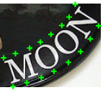
RARE for Irregular Text Recognition
Supervised STN
Localization Network
Grid
Generator
C
Fiducial Points
P
Sampler V
Rectified Image I'
Input Image I
Synthetic dataset with fiducial points to supervise the predicted C.
Method | IIIT5K | SVT | IC03 | IC13 | SVT-Per | CUTE80
SRN | 83.6 | 84.9 | 93.6 | 91.8 | 68.2 | 62.5
STN+SRN | 88.2 | 86.7 | 93.4 | 92.7 | 76.8 | 76.7
STN(Supervised)+SRN | 88.8 | 87.9 | 94.1 | 94.0 | 77.7 | 78.8

Slide 40
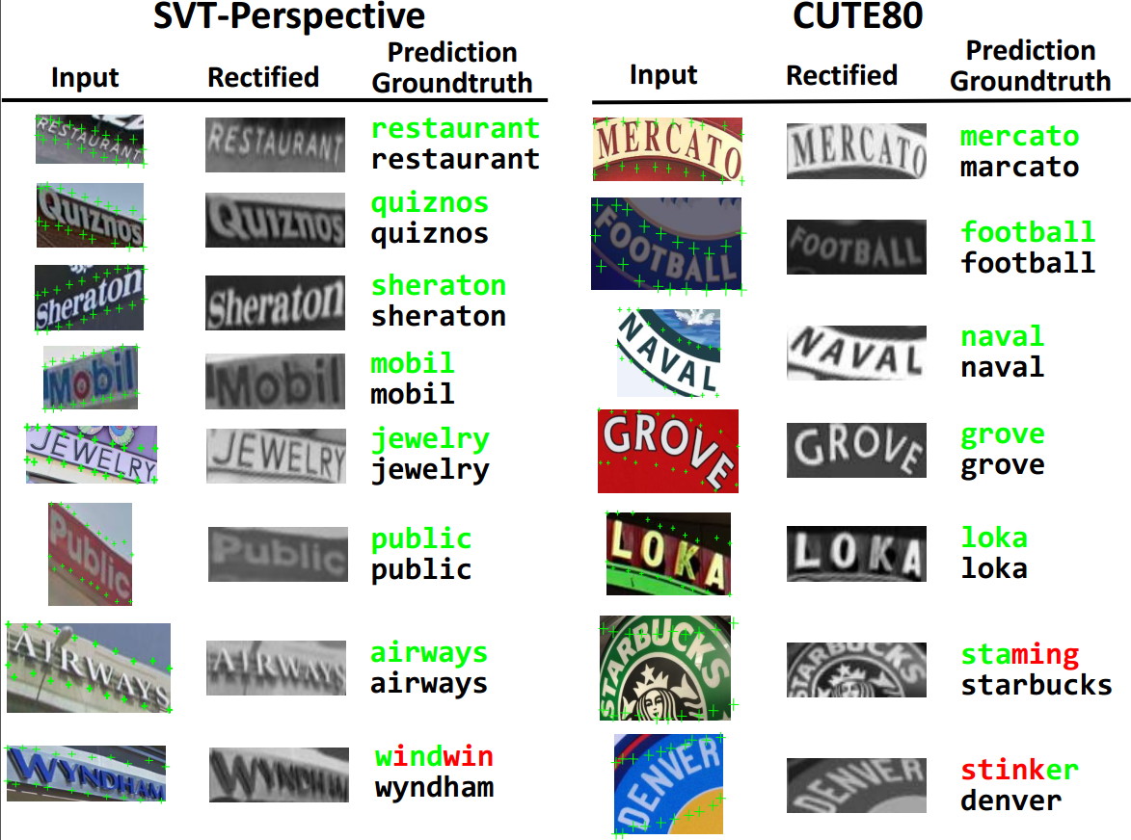
RARE for Irregular Text Recognition
Rectification Visualization

Slide 41
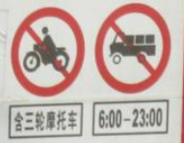

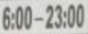
Recognition is helpful to detection
0.78
Detection Score
Recognition Score
Detector
Combined Score
0.32
0.80
0.91
Combine
0.34
Recognizer
0.91
0.90
0.92
0.89

Slide 42
Combination of TextBoxes++ and CRNN
Detection and recognition are combined by
Detection score
Recognition score
Text detection results on ICDAR 2015 Incidental Scene Text dataset
Methods | Recall | Precision | F-score
Detection | 0.785 | 0.878 | 0.829
Detection + Recognition | 0.792 | 0.912 | 0.848

Slide 43
Outline
Background
Scene Text Detection
Scene Text Recognition
Applications
Future Trends

Slide 44
Applications
Fine-Grained Image Classification with Textual Cue
Number-based Person Re-Identification
From Text Recognition to Person Re-Identification

Slide 45
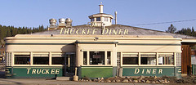
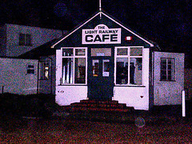

Fine-Grained Image Classification with Textual Cue
Motivations
TRUCKEE DINER
CAFE
COFFEE
(a)
(b)
(c)
Visual cues would group (a)-(b) whereas scene would group (b)-(c).
Texts in images can improve the performance of fine-grained image classification.
[1] Bai X. et al. Integrating Scene Text and Visual Appearance for Fine-Grained Image Classification with Convolutional Neural Networks[J]. arXiv:1704.04613, 2017.

Slide 46
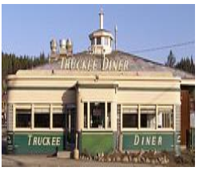
Fine-Grained Image Classification with Textual Cue
Pipeline
Feature Concatenation
GoogLeNet
Image Feature
Restaurant
Word
Spotting
Classification
Word
Embedding
TRUCKEE
DINER
Attention
Detection
Recognition
Text Feature
Attended Text Feature
[1] Bai X. et al. Integrating Scene Text and Visual Appearance for Fine-Grained Image Classification with Convolutional Neural Networks[J]. arXiv:1704.04613, 2017.

Slide 47
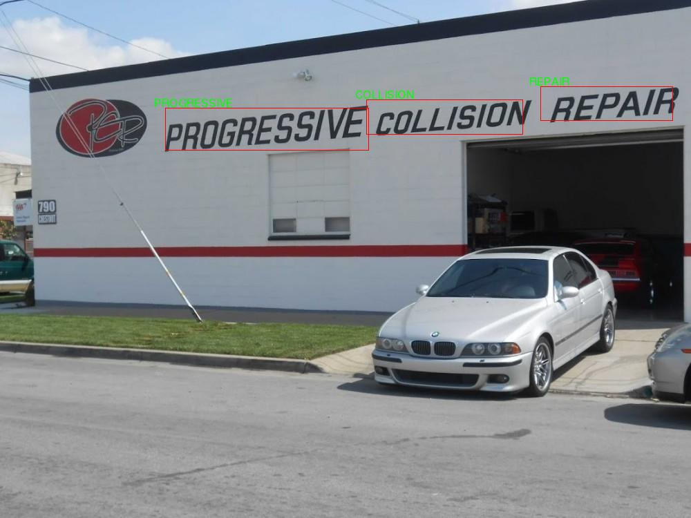
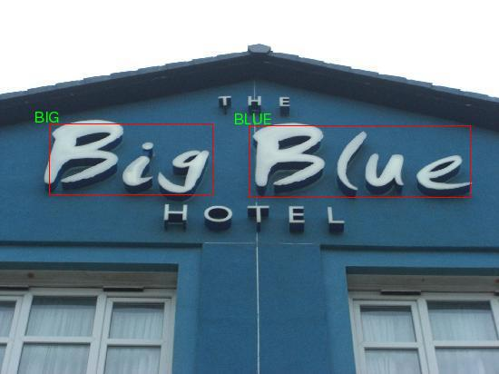
Fine-Grained Image Classification with Textual Cue
Attention Model to Select Relevant Words
COLLISION
REPAIR
THE
PROGRESSIVE
BIG
BLUE
HOTEL
Repair shop
Hotel
Some irrelevant words to this Category

Slide 48
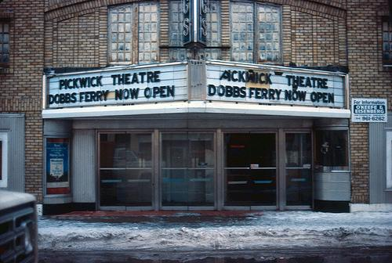
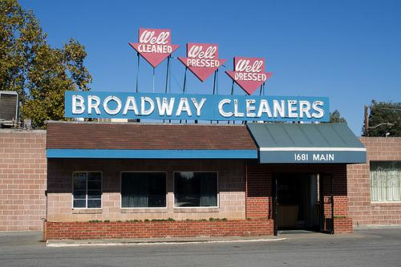

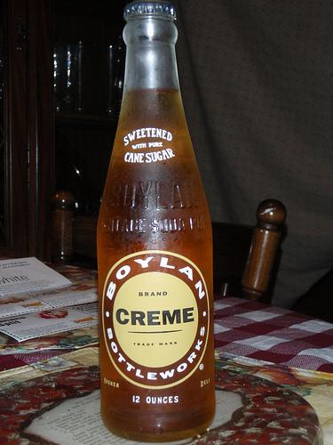




Fine-Grained Image Classification with Textual Cue
Con-Text dataset^{[1]}
Drink Bottledataset^{[2]}
28 categories of Scenes
24,255 images in total
Selected from ImageNet
20 categories of Drink Bottles
18,488 images in total
[1] S. Karaoglu. et al. Con-text: text detection using background connectivity for fine-grained object classification. ACM2013 [2] Bai X. et al. Integrating Scene Text and Visual Appearance for Fine-Grained Image Classification with Convolutional Neural Networks[J]. arXiv2017.

Slide 49
Fine-Grained Image Classification with Textual Cue
Results: mAP(%) improvement on different datasets
Method | Dataset
 | Con-Text | Drink Bottle
GoogLeNet^{[1]} | 61.3 | 63.1
GoogLeNet + Textual Cue | 79.6 (+18.3) | 72.8 (+9.7)
[1] C. Szegedy, et al. Going deeper with convolutions. CVPR2015

Slide 50


Fine-Grained Image Classification with Textual Cue
Visualization: learned weights of recognized words
BAKERY
CAKES: 0.57
PASTRIES: 0.43
OPEN: 5.5e-9
...
CAFE
STARBUCKS: 1
SCOFF: 1.1e-8
…
ROOTBEER
ROOT: 0.89
BEER: 0.11
BREWED: 1.3e-6
…
CHABLIS
CHABLIS: 0.99
FRANCE: 8.7e-12
…
Filter the incorrect recognized words
Select more related words to the category

Slide 51








Fine-Grained Image Classification with Textual Cue
Results of Image Search
Visual cue only
··· ···
Retrieval Results
Cream
Soda
Method | mAP(%)
GoogLeNet | 48.0
GoogLeNet+Textual Cue | 60.8 (+12.8)
Root Beer
Guinness
Slivovitz
Ginger
ale
Visual and Textual Cues
··· ···
Root Beer
Sarsaparilla

Slide 52
Applications
Fine-Grained Image Classification with Textual Cue
Number-based Person Re-Identification
From Text Recognition to Person Re-Identification

Slide 53
















Number-based Person Re-Identification
Problem: hard to track and retrieve an athlete in a marathon game
Marathon athlete tracking
query
retrieval
?
Marathon image database
Motivation: every athlete has a unique racing bib number

Slide 54


Number-based Person Re-Identification
Proposed pipeline
Input Query
2895
match
Text
Detection^{[1]}
Text
Recognition^{[2]}
528
2895
Marathon Image
Localization
Recognization
Result
[1] M. Liao et al. TextBoxes: A Fast Text Detector with a Single Deep Neural Network. AAAI, 2017.
[2] Shi B, Bai X, Yao C. An end-to-end trainable neural network for image-based sequence recognition and its application to scene text recognition. TPAMI, 2017.

Slide 55





Number-based Person Re-Identification
Marathon Dataset
8706 training images, 1000 testing images
Experimental Results
Identification accuracy rate(Id_acc): 85%

Slide 56
Applications
Fine-Grained Image Classification with Textual Cue
Number-based Person Re-Identification
From Text Recognition to Person Re-Identification

Slide 57

From Text Recognition to Person Re-Identification
Sequence Modeling
Text Recognition (CRNN)
Person Re-Idntification
head
···
upper body
Left-to-Right
upper leg
Top
-
···
to
-
Lower leg
Down
[1] CRNN: Shi B et al. An end-to-end trainable neural network for image-based sequence recognition and its application to scene text recognition. TPAMI, 2017.

Slide 58

From Text Recognition to Person Re-Identification
Model Architecture
CNN
+ LSTM
…
Classification
Classification
…
CNN Feature
Feature Sequence
Bi-LSTM
Results on Market1501^{[1]}
Method | mAP(%) | R1(%)
CNN | 59.8 | 81.4
CNN + LSTM | 65.5 | 85.8
R1: given a query, precision of the top-1 similar image from gallery discriminated by model.
[1] Zheng et al. Scalable Person Re-identification: A Benchmark. ICCV 2015

Slide 59



From Text Recognition to Person Re-Identification
Retrival Results
CNN
… …
query
CNN+LSTM
… …
query

Slide 60
Outline
Background
Scene Text Detection
Scene Text Recognition
Applications
Future Trends

Slide 61
Future Trends
Irregular text detection (Curved & Perspective Text Lines )
Multilingual End-to-end text recognition
Semi-supervised or weakly supervised text detection and recognition
Text image synthesis (GAN)
Unified framework for OCR and NLP
Integrating Scene text and Image/Videos for many applications.

Slide 62
Resources (Papers & Datasets & Codes)
B. Shi, C. Yao, M. Liao, M Yang, P Xu, L Cui, S Belongie, S Lu, X Bai.
ICDAR2017 Competition on Reading Chinese Text in the Wild ( RCTW-17). ICDAR’17
Dataset : http://mclab.eic.hust.edu.cn/icdar2017chinese
B. Shi, X. Bai, S. Belongie.
Detecting Oriented Text in Natural Images by Linking Segments. CVPR'17
Code: https://github.com/bgshih/seglink
M. Liao, B. Shi, X. Bai, X. Wang, W. Liu.
TextBoxes: A fast text detector with a single deep neural network. AAAI'17
Code: https://github.com/MhLiao/TextBoxes
B. Shi, X. Bai, C. Yao.
An end-to-end trainable neural network for image-based sequence recognition and its application to scene text recognition. TPAMI’17
Code: http://mclab.eic.hust.edu.cn/~xbai/CRNN/crnn_code.zip
B. Shi, , X. Wang, P. Lyu, C. Yao, X. Bai.
Robust scene text recognition with automatic rectification. CVPR’16
X. Bai, M. Yang, P. Lyu, et al.
Integrating Scene Text and Visual Appearance for Fine-Grained Image Classification arXiv2017.

Slide 63
Literature review (Papers & PPTs)
[Survey Paper]
Scene text detection and recognition: Recent advances and future trends.
Y Zhu, C Yao, X Bai.
Frontiers of Computer Science 10 (1), 19–36, 2016.
http://mclab.eic.hust.edu.cn/UpLoadFiles/Papers/FCS_TextSurvey_2015.pdf
[Talk PPT in 2014]
Representation in Scene Text Detection and Recognition.
http://mclab.eic.hust.edu.cn/~xbai/Talk_slice/Representation%20in%20Scene%20Text%20Detection%20and%20Recognition_20150207.pdf
[Talk PPT in 2017]
Oriented Scene Text Detection Revisited.
http://mclab.eic.hust.edu.cn/~xbai/Talk_slice/Oriented-Scene-Text-Detection-Revisited_VALSE2017.pdf

Slide 64







Collaborators
Cong Yao.
Cloud Team chief, Megvii Inc.
Baoguang Shi.
PHD Candidate, HUST
Zheng Zhang.
Associate Researcher, MSRA
Chengquan Zhang.
Researcher, Baidu IDL
Minghui Liao.
PHD student, HUST
Mingkun Yang.
Master student, HUST
Serge Belongie.
Professor, Cornell

Slide 65

Refer to my homepage for more details
Thank you !

